Slide 1
FANTASY BOOK EMPORIUM
Arcane
Pages
Epic
Legends
Dungeon
Grimoire
Wizard
Tales
An e-commerce website for fantasy books: D&D guides, epic novels, magical school stories, and dark fantasy sagas.
Presenters: Your Group Names
10 min presentation + 5 min Q&A
Arcane Pages | Fantasy Books E-Commerce Prototype

Slide 2
Motivation / Purpose
Why this website exists
Arcane Pages gives fantasy readers one magical place to discover and buy books that match their adventure mood.
📚
Product Focus
One product category only: fantasy books. Examples include tabletop RPG manuals, epic fantasy novels, dark fantasy books, and magic school adventures.
⚔️
Help students, readers, and tabletop players browse fantasy books quickly.
🧙
Target Users
📜
Show a complete front-end e-commerce design without an admin page or CMS.
Fantasy readers, D&D players, students looking for novels, and hobbyists who enjoy lore-heavy stories.
✨
Create a shop identity that fits the fantasy theme through colors, typography, and interaction.
🛡️
Project Scope
Static front-end prototype using HTML, CSS, and JavaScript. No database, admin page, or CMS required.
Arcane Pages | Fantasy Books E-Commerce Prototype

Slide 3
Website Functions
Main features demonstrated in the prototype
🔎
Search & Filter
📖
Product Cards
🛒
Cart Counter
Users can search by title/theme and filter by fantasy type, such as tabletop RPG, epic fantasy, dark fantasy, and magic school.
Each book has a fantasy cover card, title, category, short description, sample peso price, and Add button.
The cart count increases when a user clicks Add, showing simple interactive behavior.
✉️
Order Request
📱
Responsive Layout
🌙
Fantasy Design
A checkout-style form simulates buyer inquiries and order messages.
The website adjusts from desktop grid to smaller mobile-friendly layouts.
Dark castle palette, gold accents, glowing effects, and book-cover visuals support the theme.
Technology used: HTML + CSS + JavaScript
Arcane Pages | Fantasy Books E-Commerce Prototype

Slide 4
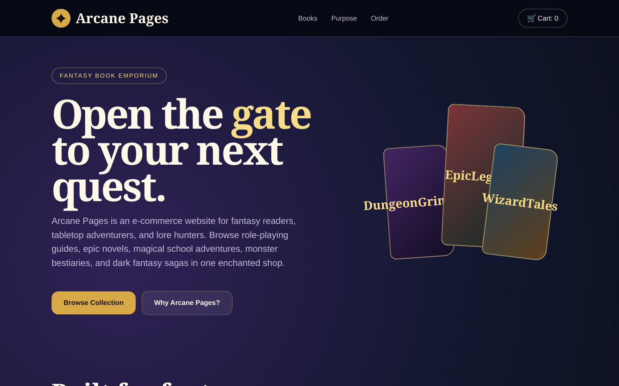
Screenshot: Homepage
First impression and website identity
🏰
Description
The homepage introduces Arcane Pages with a fantasy bookstore identity, main call-to-action buttons, navigation, and cart display.
✨
Design Choice
Large heroic title, glowing gold accents, dark magical background, and floating fantasy books create the theme immediately.
🧭
Usability
Navigation links let users jump to Books, Purpose, and Order sections without confusion.
Arcane Pages | Fantasy Books E-Commerce Prototype

Slide 5
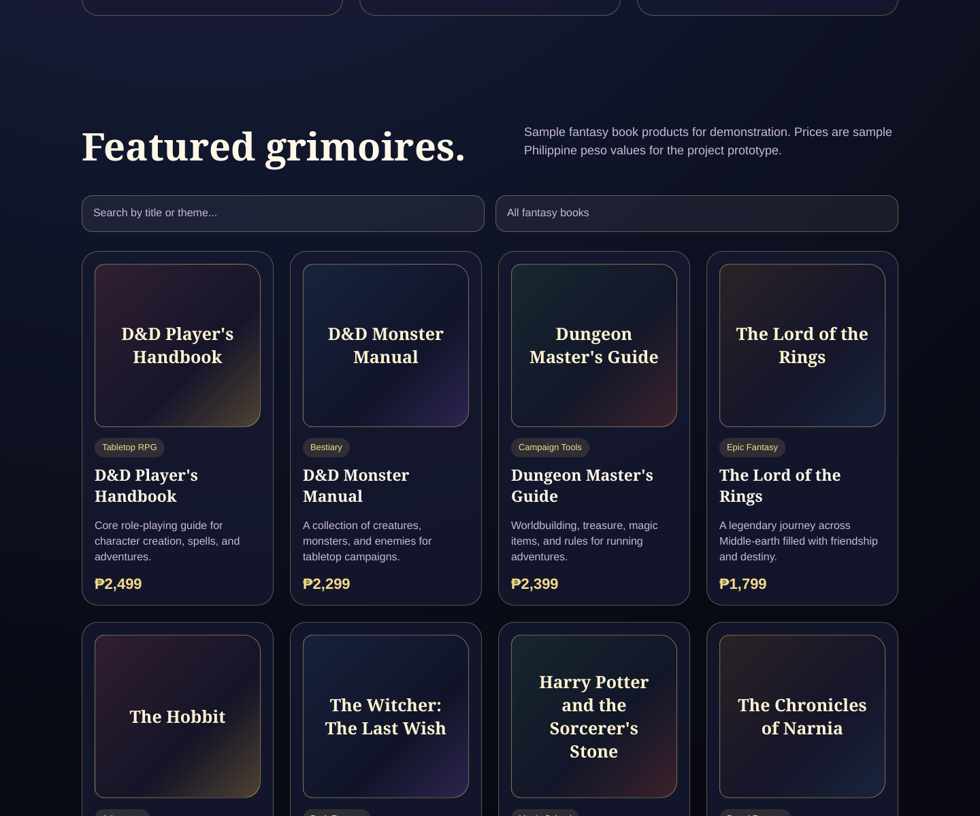
Screenshot: Book Collection
Product browsing section
📚
Product Catalog
Fantasy books are displayed as cards with title, category tag, description, sample price, and add button.
🔎
Browsing Tools
Search and filter controls make it easier to find a specific fantasy theme or title.
🗂️
Product Scope
All products stay within one clear product type: fantasy books, avoiding unrelated product groups.
Arcane Pages | Fantasy Books E-Commerce Prototype

Slide 6
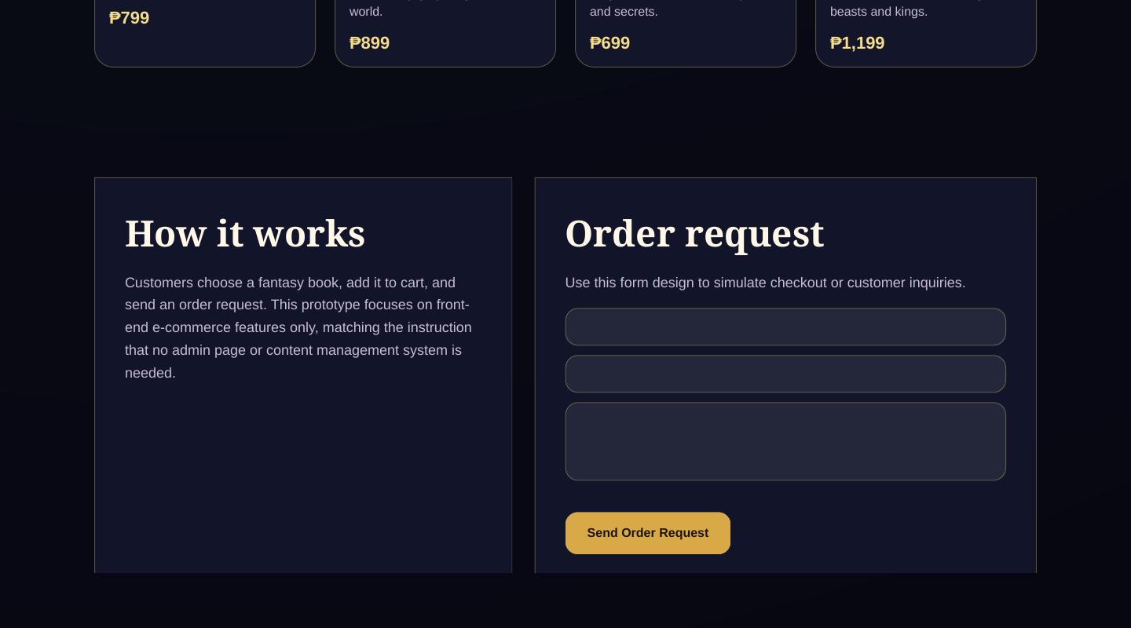
Screenshot: Order Request
Checkout simulation / inquiry form
🛒
How it Works
Users choose a book, add it to cart, then send an order request using the form.
🛡️
Reliability
The page is simple and static, so it loads quickly and avoids unnecessary database or admin features.
⚡
Performance
No heavy images or external libraries are needed; most visuals are made with CSS.
Arcane Pages | Fantasy Books E-Commerce Prototype

Slide 7
Rubric Alignment + Q&A
How the project meets the scoring criteria
Functional Suitability
Search, filter, cart counter, product catalog, and order request form meet e-commerce needs.
20 pts
Performance Efficiency
Lightweight HTML/CSS/JS design uses minimal resources and no database dependency.
20 pts
Usability
Simple navigation, readable product cards, clear buttons, and responsive layout.
20 pts
Reliability
Static structure and basic JavaScript reduce failure points during presentation.
20 pts
Design
Fantasy style supports the product type through colors, typography, glowing accents, and book visuals.
20 pts
Presentation timing: 10 minutes for website explanation + 5 minutes for questions.
Arcane Pages | Fantasy Books E-Commerce Prototype

